Slide 1

the worldwide relay for peace
the worldwide relay for peace
RUN4UNITY THE WORLDWIDE RELAY FOR PEACE

Slide 2

THE WORLDWIDE
RELAY FOR PEACE
RUN4UNITY THE WORLDWIDE RELAY FOR PEACE

Slide 3
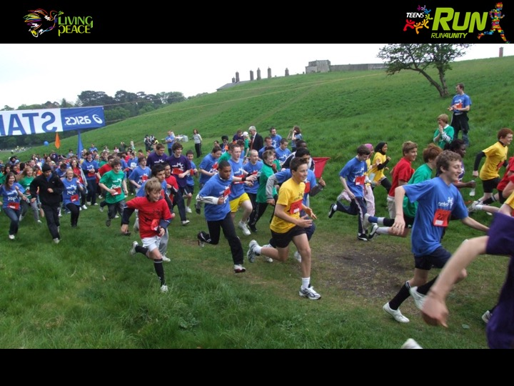
RUN4UNITY THE WORLDWIDE RELAY FOR PEACE

Slide 4
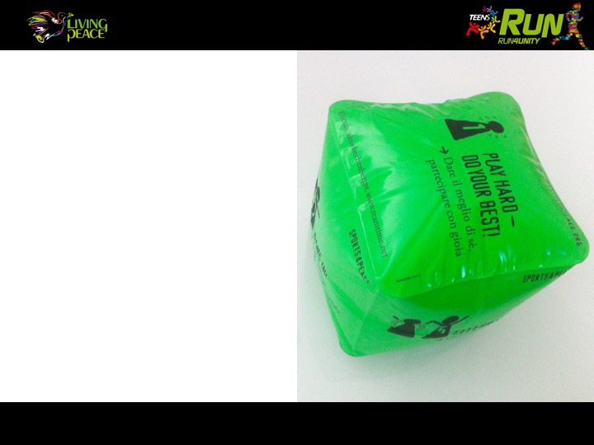
“Run4unity – with the
cube Sport4peace – is based on “The Golden Rule”.
RUN4UNITY THE WORLDWIDE RELAY FOR PEACE

Slide 5
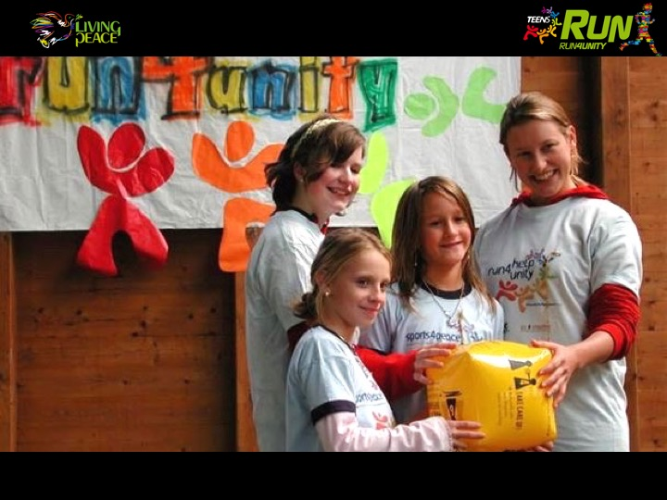
Do unto others as you would have them do unto you " similar forms is present in all cultures and religions
“Do unto others as you would have them do unto you" a similar form is present in all cultures and religions.
RUN4UNITY THE WORLDWIDE RELAY FOR PEACE

Slide 6
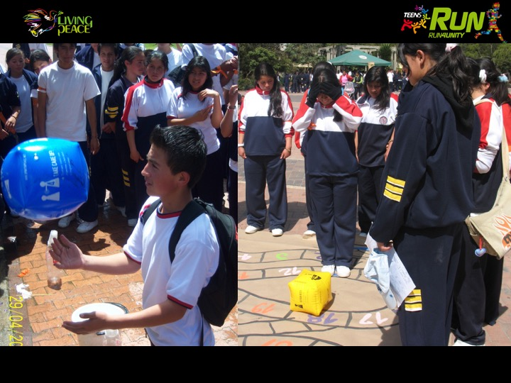
RUN4UNITY THE WORLDWIDE RELAY FOR PEACE

Slide 7
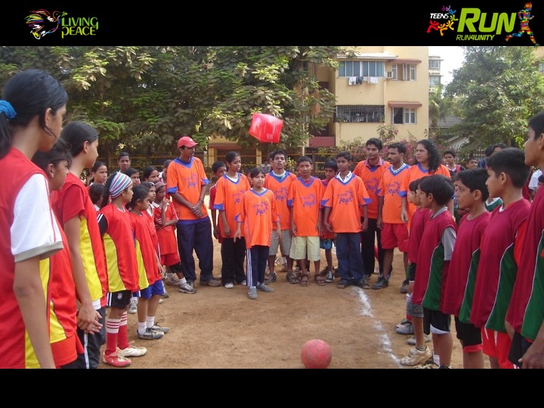
RUN4UNITY THE WORLDWIDE RELAY FOR PEACE

Slide 8
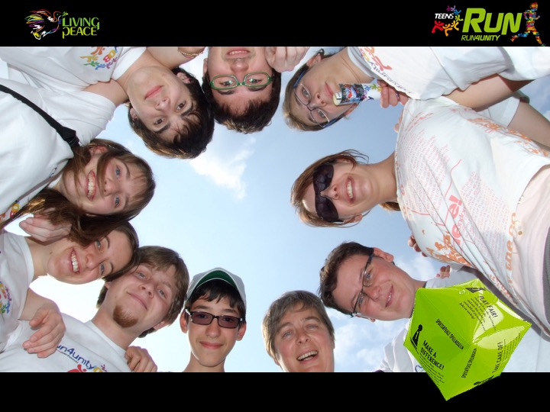
1
Play hard – Do your best!
GIVE THE BEST OF YOURSELF,
PARTICIPATE WITH JOY.
RUN4UNITY THE WORLDWIDE RELAY FOR PEACE

Slide 9
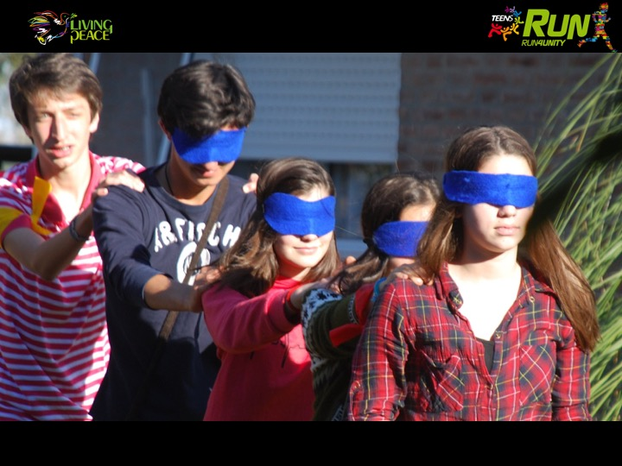
RUN4UNITY THE WORLDWIDE RELAY FOR PEACE

Slide 10
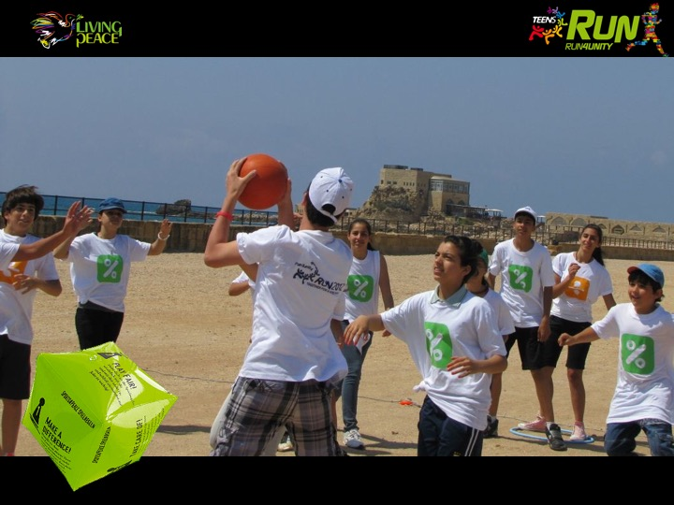
2
Play fair!
BE HONEST WITH YOURSELF
AND WITH OTHERS.
RUN4UNITY THE WORLDWIDE RELAY FOR PEACE

Slide 11
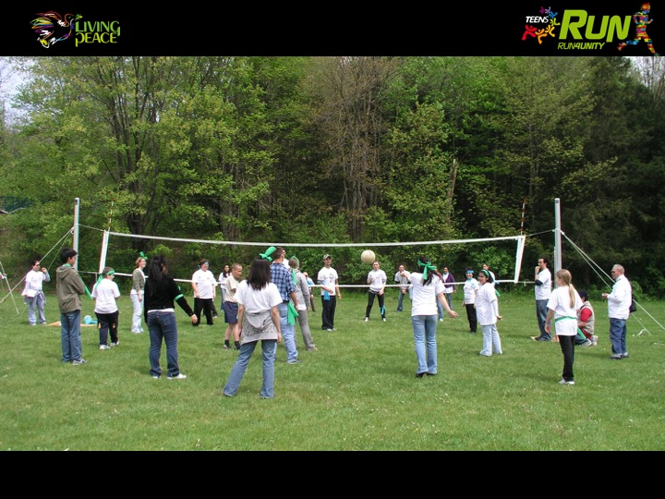
RUN4UNITY THE WORLDWIDE RELAY FOR PEACE

Slide 12
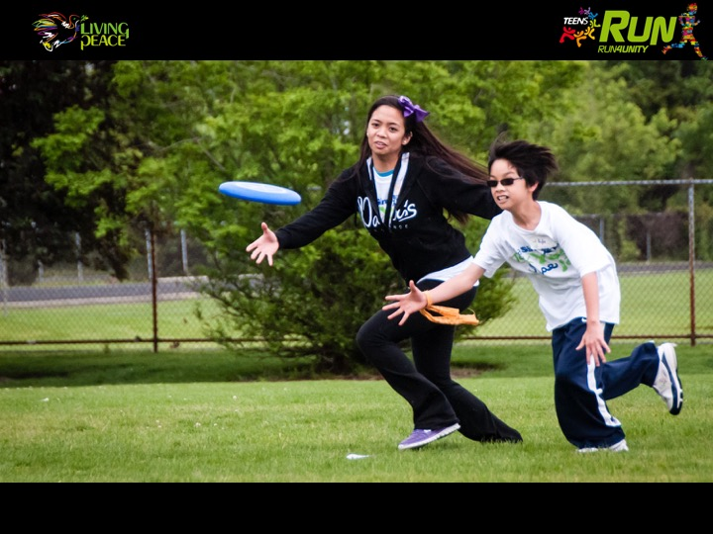
RUN4UNITY THE WORLDWIDE RELAY FOR PEACE

Slide 13
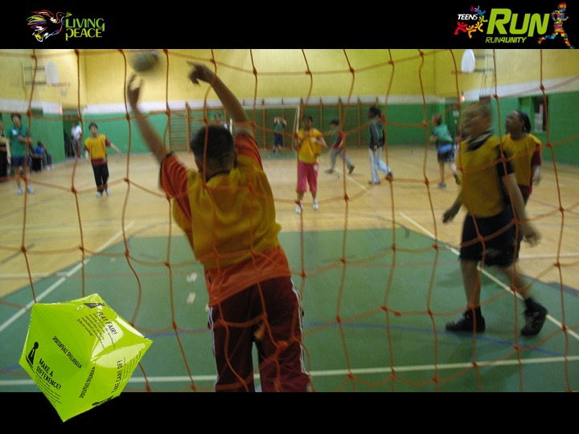
3
Hang in!
DON’T EVER GIVE UP,
EVEN WHEN IT GETS TOUGH.
RUN4UNITY THE WORLDWIDE RELAY FOR PEACE

Slide 14
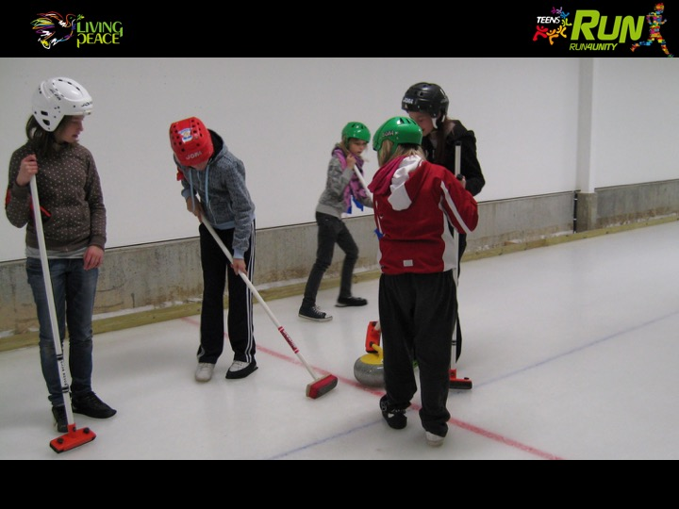
RUN4UNITY THE WORLDWIDE RELAY FOR PEACE

Slide 15
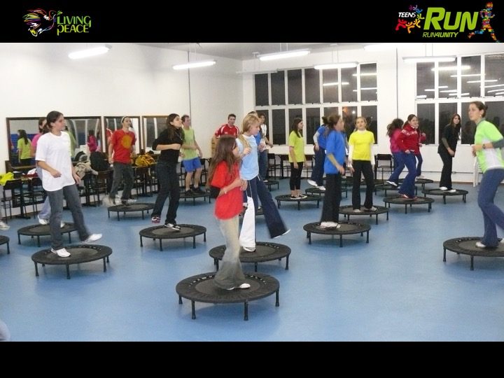
RUN4UNITY THE WORLDWIDE RELAY FOR PEACE

Slide 16
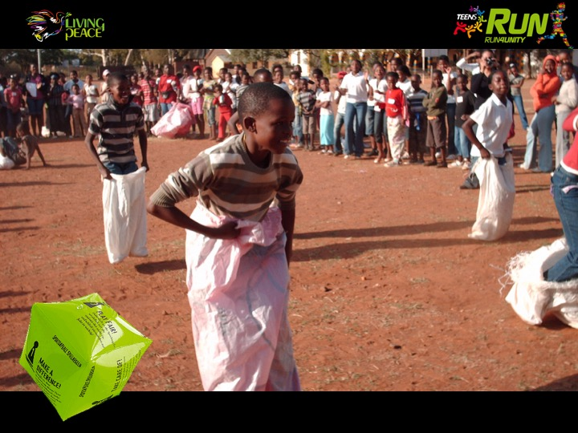
4
Take care of!
TREAT EVERYONE WITH RESPECT: EACH PERSON IS IMPORTANT.
RUN4UNITY THE WORLDWIDE RELAY FOR PEACE

Slide 17
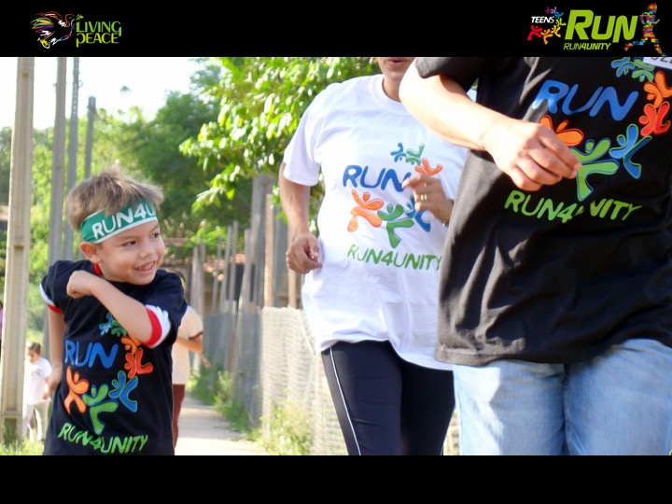
RUN4UNITY THE WORLDWIDE RELAY FOR PEACE

Slide 18
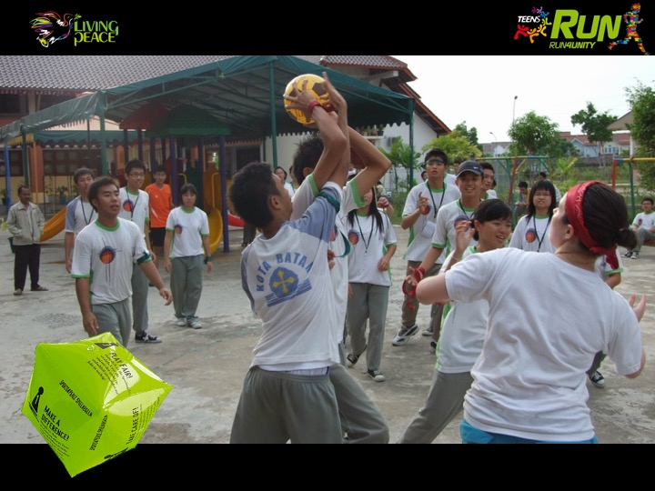
5
Celebrate!
APPLAUD OTHERS’ SUCCESS AS YOUR OWN.
RUN4UNITY THE WORLDWIDE RELAY FOR PEACE

Slide 19
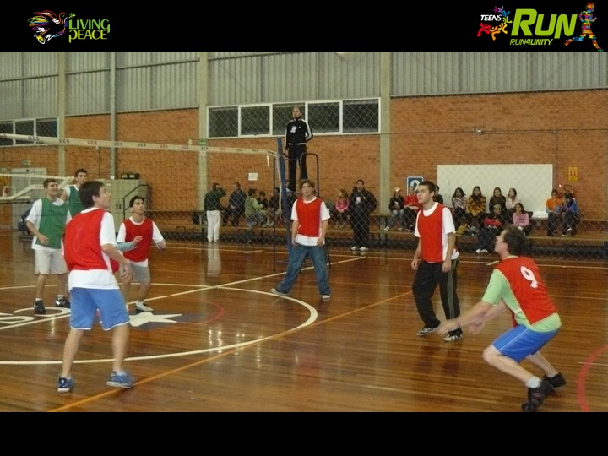
RUN4UNITY THE WORLDWIDE RELAY FOR PEACE

Slide 20
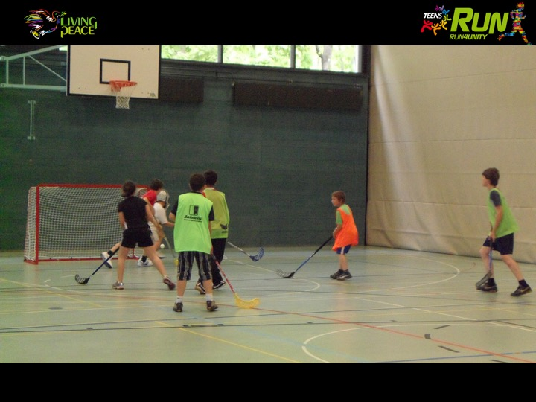
RUN4UNITY THE WORLDWIDE RELAY FOR PEACE

Slide 21
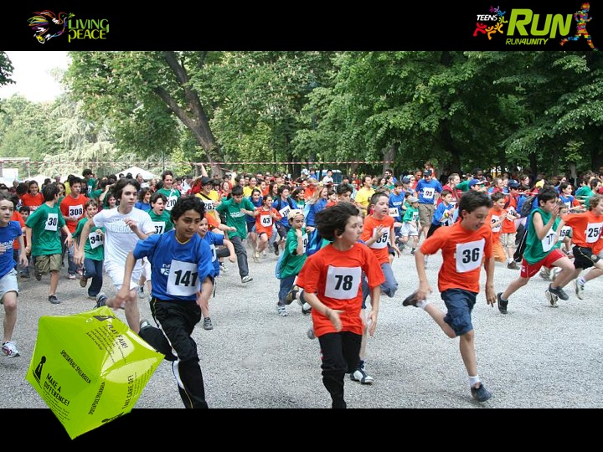
6
Make a difference!
IT’S ONLY TOGETHER THAT WE CAN REACH GREAT GOALS.
RUN4UNITY THE WORLDWIDE RELAY FOR PEACE

Slide 22
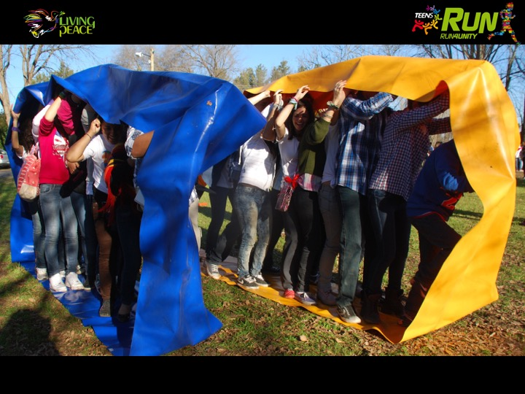
RUN4UNITY THE WORLDWIDE RELAY FOR PEACE

Slide 23
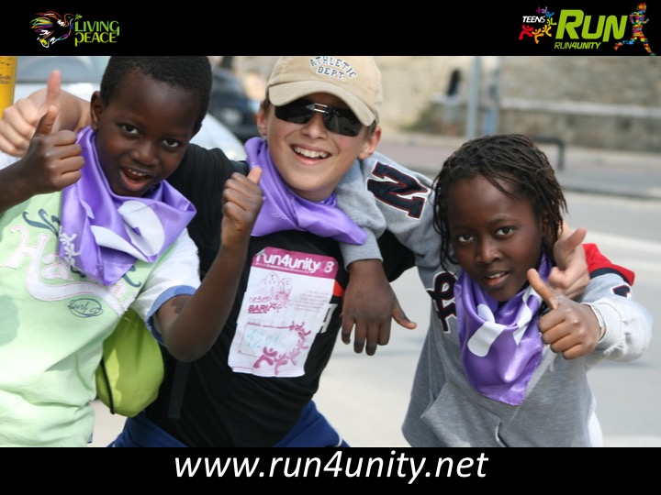
WE’LL BE WAITING FOR YOU

